Slide 1

Efficient Acoustic Modelling of Large Spaces using Time Domain Methods
The Evaluation of Three Time Domain Numerical Methods for Solving the Acoustic Wave Equation, Applied to Solving Large Domains
S Durbridge
May 2017

Slide 2
Efficient Acoustic Modelling of Large Spaces using Time Domain Methods
Motivation
Acoustic Modelling Methods
Experiment
Conclusion
References

Slide 3
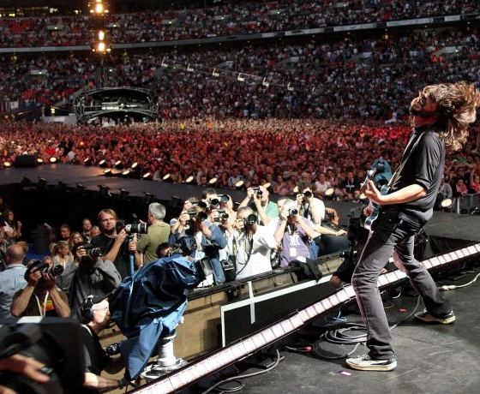
Motivation
Why model large domains?
http://www.wallpaperup.com/187034/music_live_Foo_Fighters_Dave_Grohl.html

Slide 4
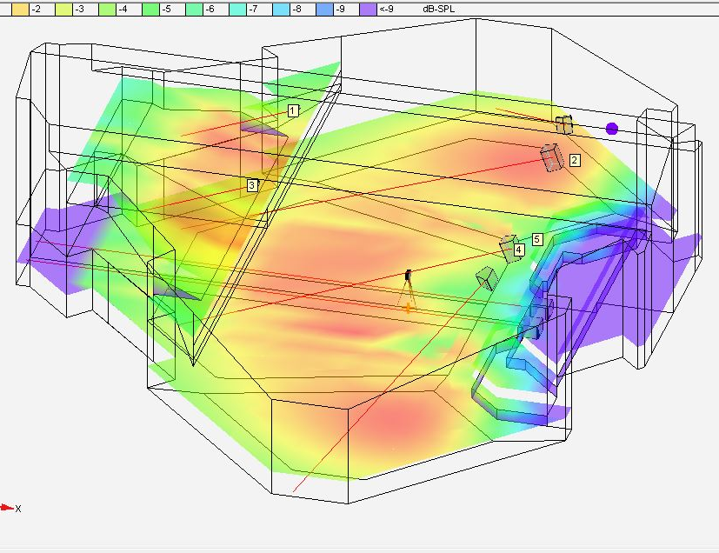
Sound System Design
Prototype array configurations
Try different systems
Placement
Time of arrival
Equalisation
Office Virtual Soundcheck
Optimise design for intelligibility
Improve deployment time
Build a basic system ‘image’ in model
Tweak system settings on the day
Prototype system tools
Adaptive (dynamic) filtering
Spectral tilt for line arrays
Dynamic array steering
http://toneproperav.com/design-1/

Slide 5
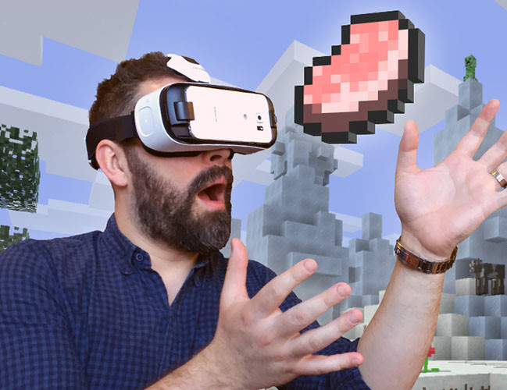
Auralization
Virtual Reality
Video Games
Home Entertainment
Evaluation of building and system designs prior to build
https://www.rt.com/usa/341199-minecraft-goes-vr/

Slide 6
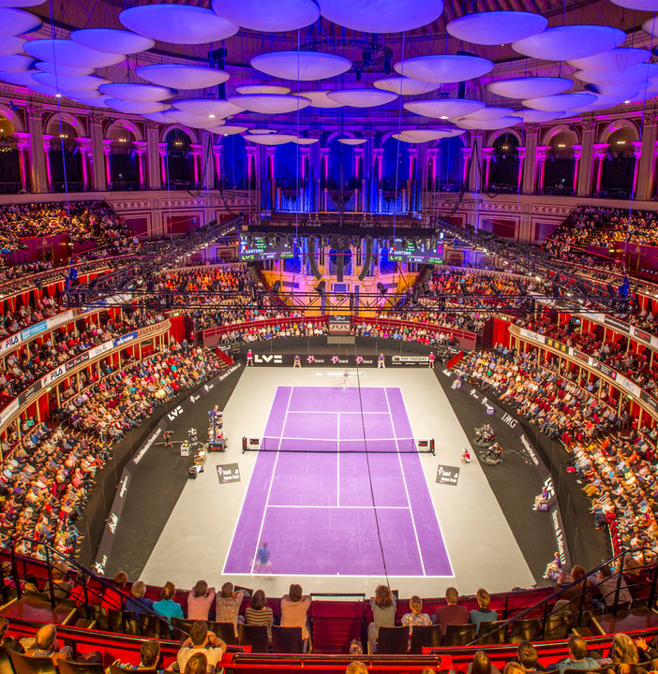
Large Room Acoustic Properties
Wave Acoustics
Reverberation
Direct to Reverberant Ratio
Room Modes
http://www.royalalberthall.com/tickets/events/2017/champions-tennis//

Slide 7
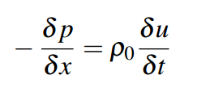
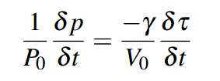
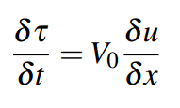
Wave Acoustic
Physical Basis
Momentum Equation
Gas Law
Conservation of Mass
Notes:
P pressure
X = x direction
u = velocity
t = time
P0 = ambient pressure
y = Adiabatic gas constant for air
V0 = gas density
tau = displacement of the volume

Slide 8
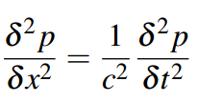
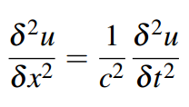
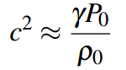
Wave Acoustic
Wave Equation

Slide 9
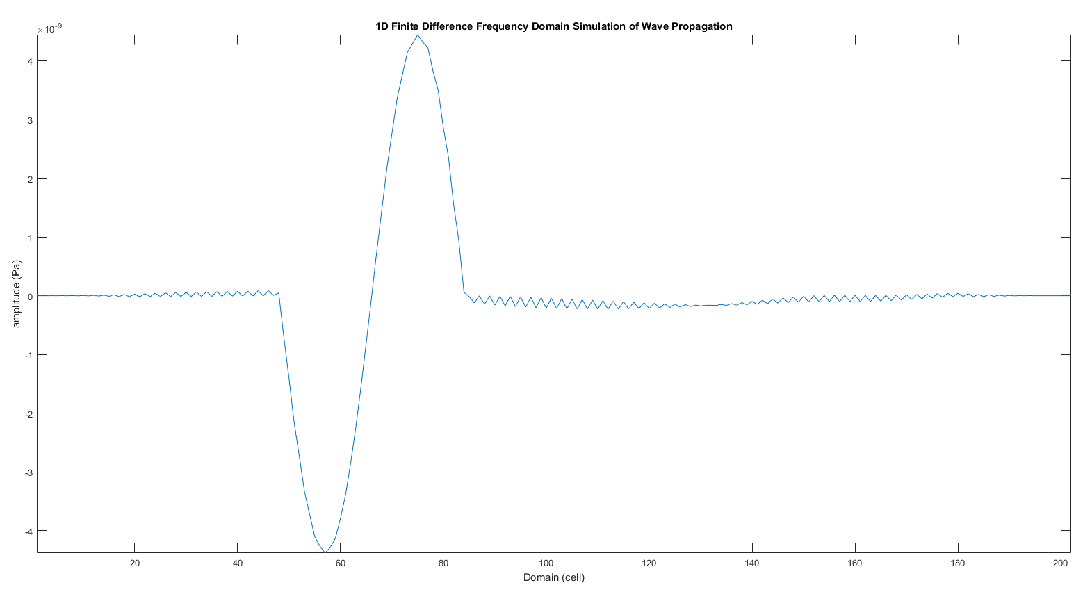
Wave Acoustic

Slide 10
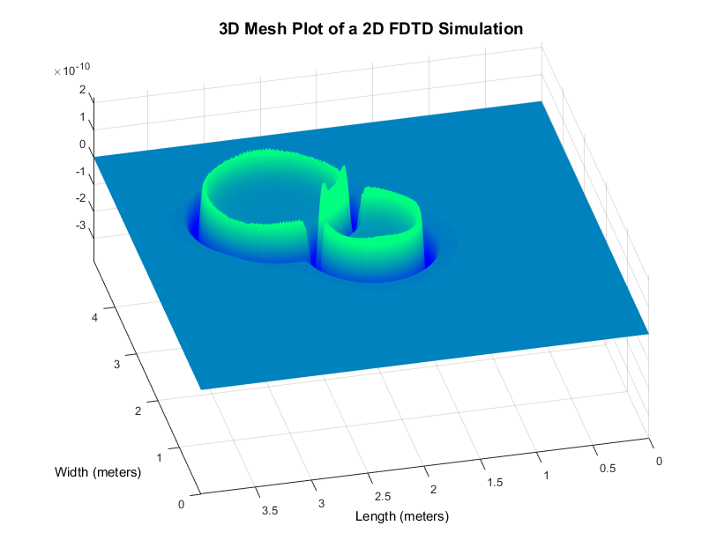
Wave Acoustic

Slide 11
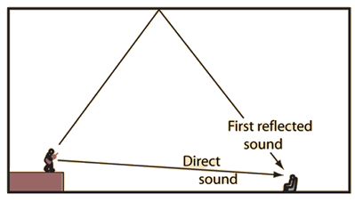
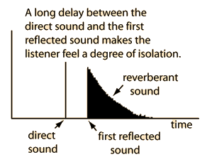
Reverberation
Reflections
http://hyperphysics.phy-astr.gsu.edu/hbase/Acoustic/refdel.html

Slide 12
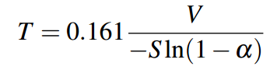
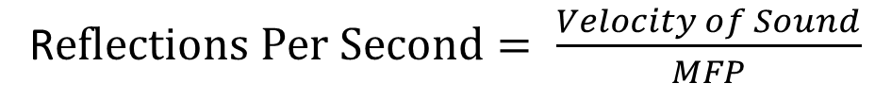
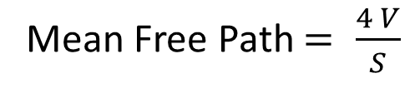
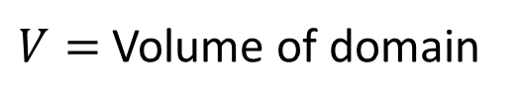
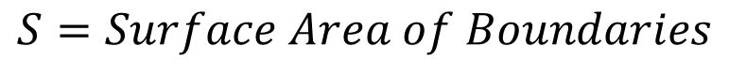
Reverberation
Norris-Eyring Reverberation Time Equation (RT60)
$$S=Surface Area of Boundaries$$
$V=$Volume of domain
Mean Free Path $= \frac{4 V}{S}$
R$eflections Per Second= \frac{Velocity of Sound}{MFP}$

Slide 13
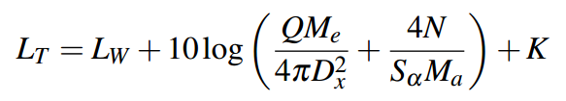
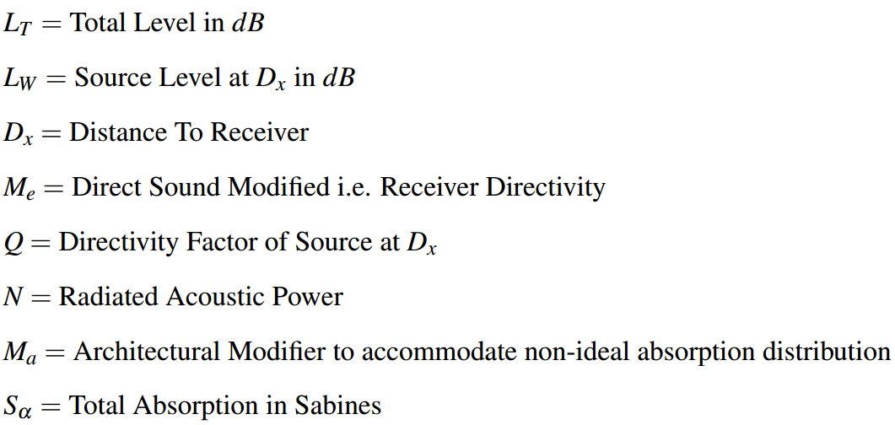
Direct to Reverberant Ratio
Modified Hopkins-Stryker Equation

Slide 14
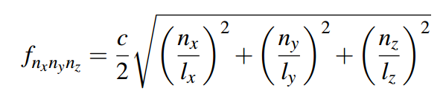
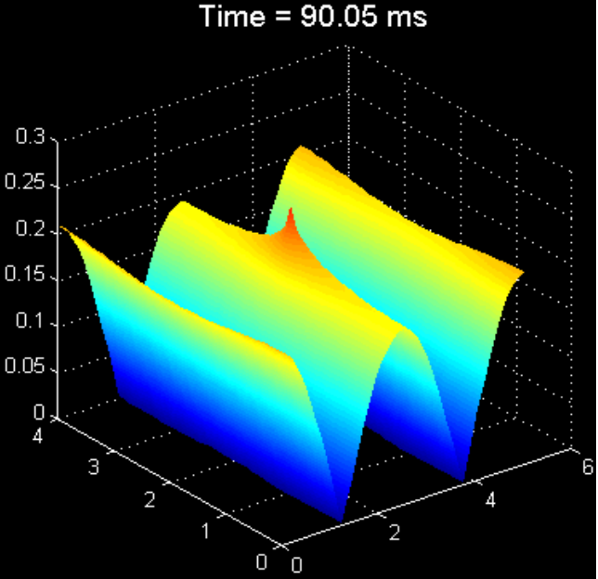
Room Modes
Room Eigenfrequency Equation
C = speed of sound
n = resonance order
l = dimension
http://adamjhill.com/AJHILL/wp-content/uploads/2017/05/Hill-PhD-Thesis.pdf

Slide 15
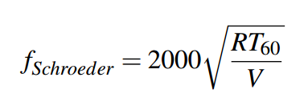
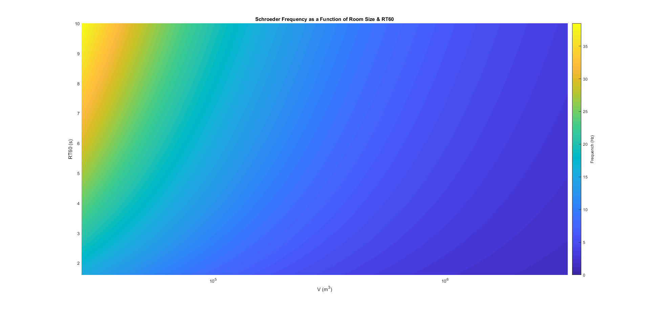
Room Modes
Schroeder Frequency
http://www.linkwitzlab.com/rooms.htm

Slide 16
Recap
Wave propagation
Force = Mass * Acceleration
Longitudinal Waves
Ripples of pressure
Reverberation
Acoustic waves reflect and scatter
May increase loudness – Haas Effect
May decrease intelligibility – Masking & Direct to Reverberant Ratio
Balance of acoustic absorption and sound system power can improve direct to reverberant ratio
Room Modes
Locally extreme pressure fluctuations
May cause spectral imbalance across domain
Schroeder Frequency can be very low in large domains with appropriate reverb decay times

Slide 17
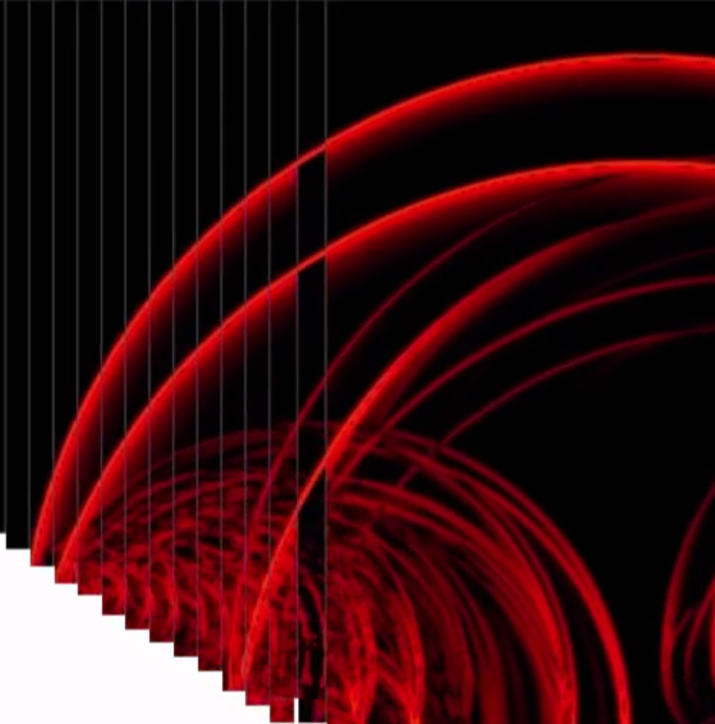
Acoustic Modelling Methods
Physical Models
Parameter Approximation Equations
Ray Tracing
Numerical Methods
Finite Element Methods
Boundary Element Methods
Finite Difference Methods
Sparse Finite Difference Time Domain
Finite Difference Frequency Domain

Slide 18
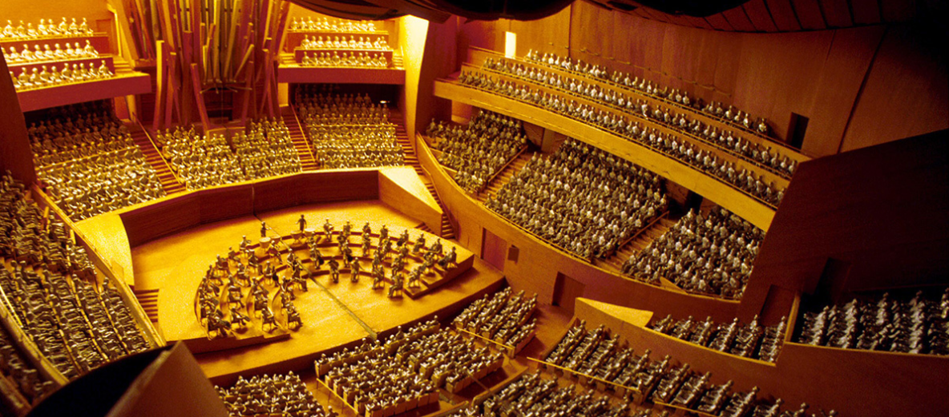
http://wdch10.laphil.com/wdch/acoustics.html
Physical Scale Models

Slide 19
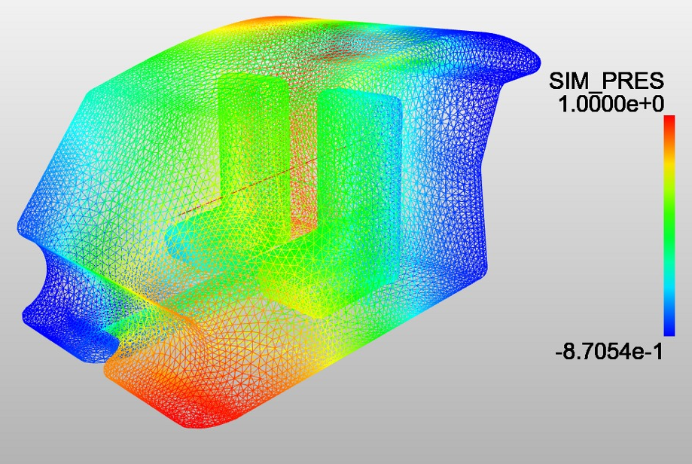
https://www.simscale.com/wp-content/uploads/2015/11/acoustic-eigenmodes.jpg
Finite Element Method

Slide 20
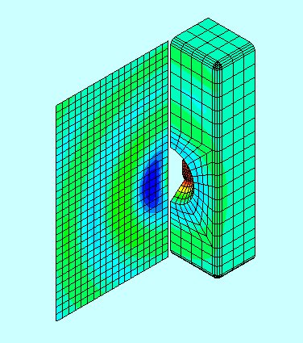
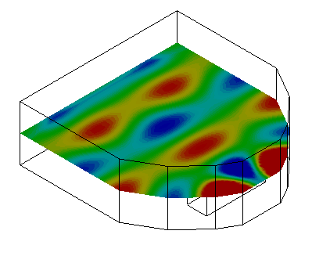
http://www.pafec.info/pafec/
Boundary Element Method

Slide 21
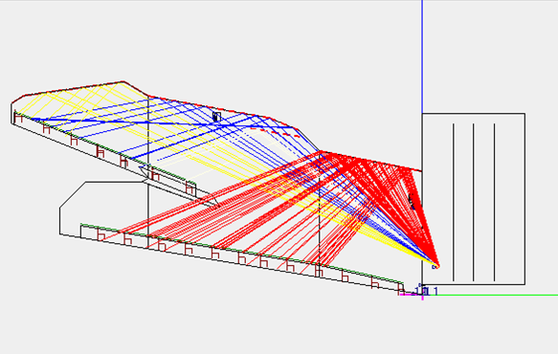
http://ease.afmg.eu/index.php/reflection-pattern-studies-with-ray-tracing.html
Ray Physics Methods

Slide 22
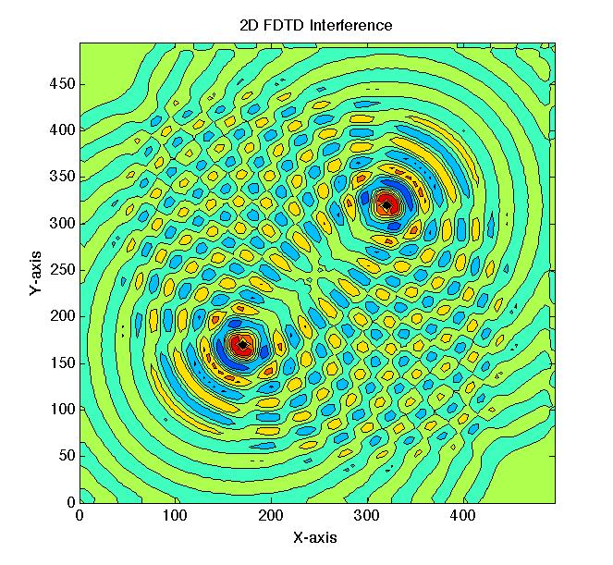
Finite Difference Methods
https://uk.mathworks.com/matlabcentral/fileexchange/55301-two-dimensional-wave-interference-using-finite-difference-time-domain-method--fdtd-

Slide 23
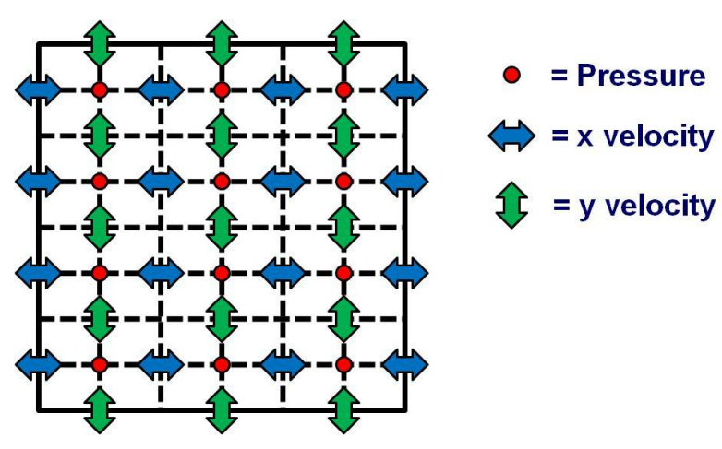
Finite Difference Methods
Domain Discretization
http://adamjhill.com/AJHILL/wp-content/uploads/2017/05/Hill-PhD-Thesis.pdf

Slide 24
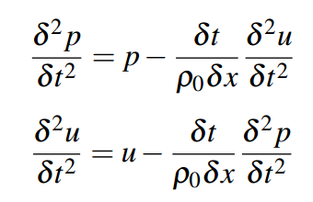
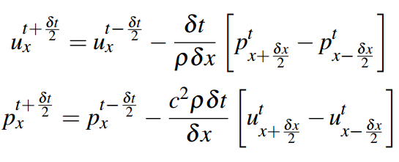
Finite Difference Methods
Update Equations

Slide 25
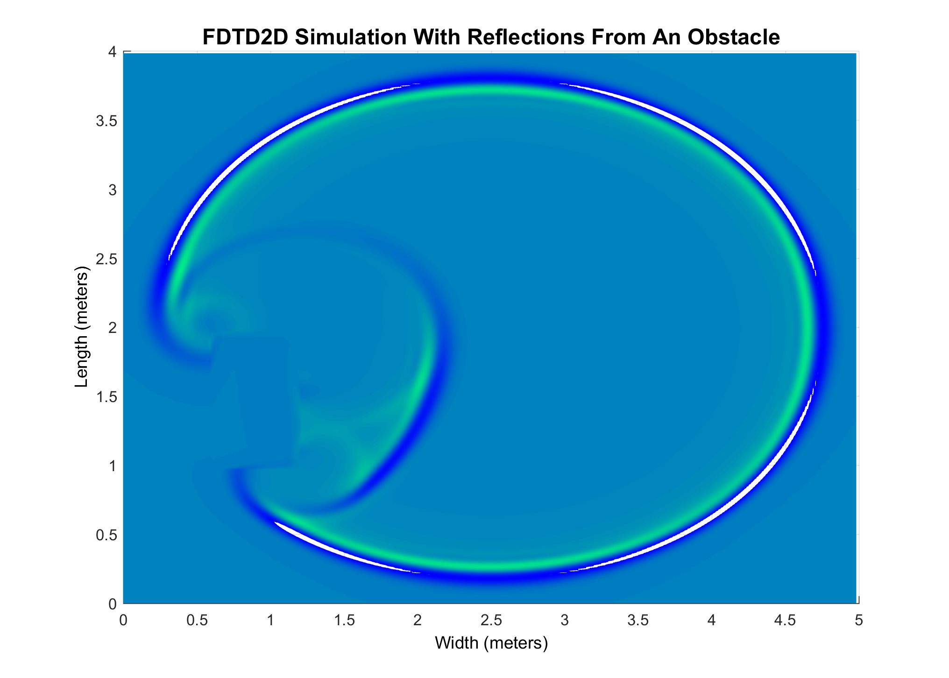
Finite Difference Methods
Finite Difference Time Domain

Slide 26
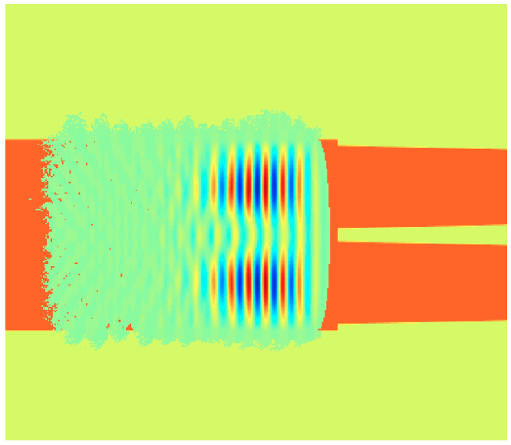
Finite Difference Methods
Sparse Finite Difference Time Domain
http://ieeexplore.ieee.org/document/6646229/

Slide 27
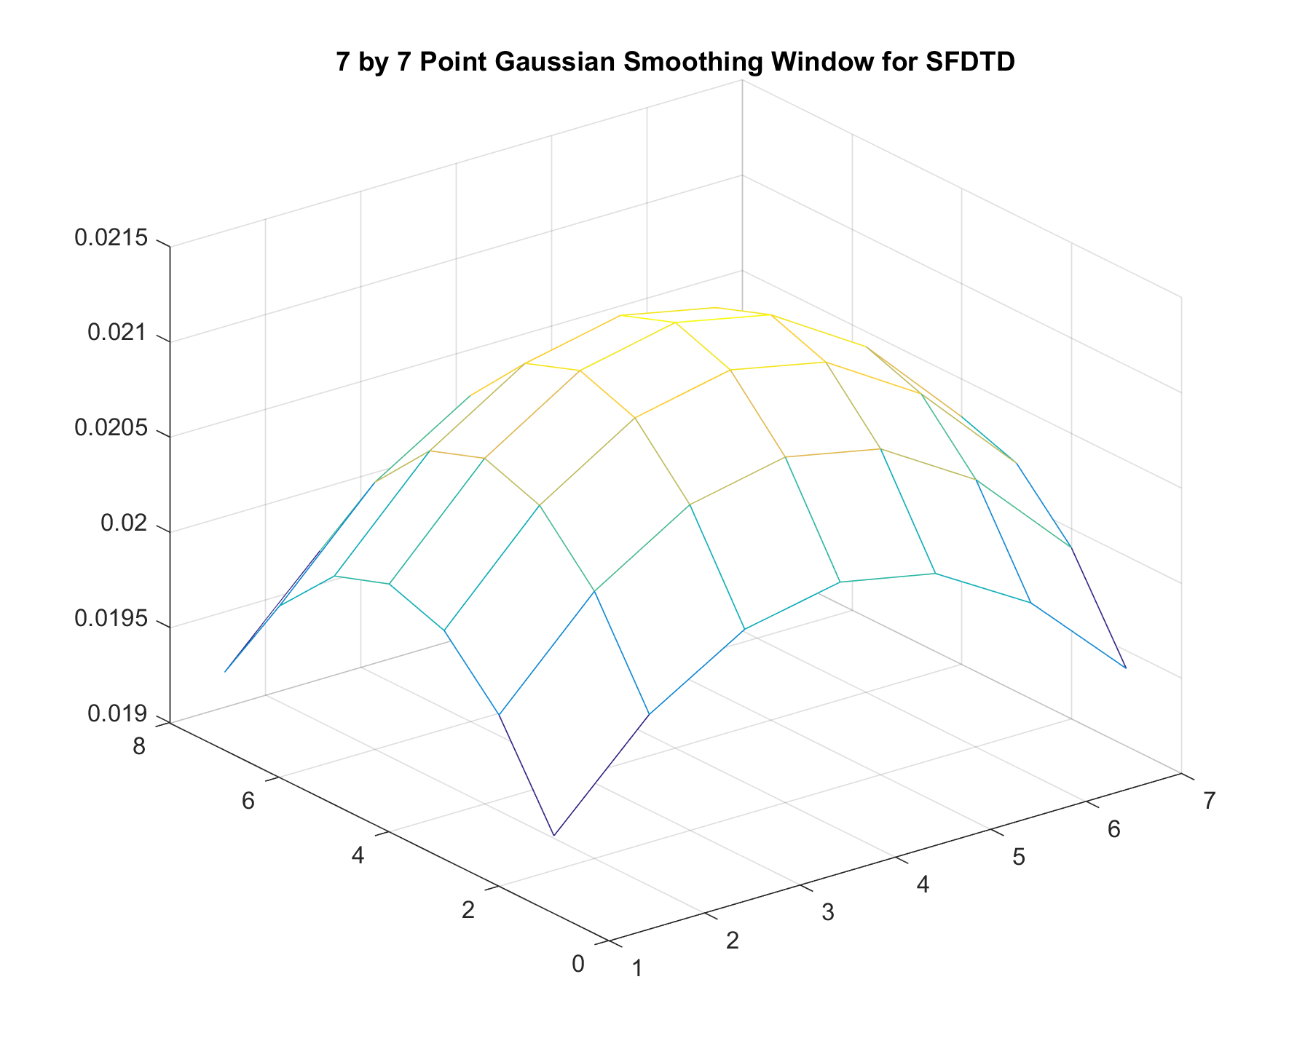
Finite Difference Methods
Sparse Finite Difference Time Domain

Slide 28
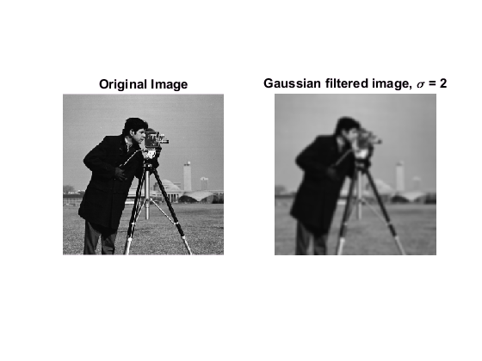
Finite Difference Methods
Sparse Finite Difference Time Domain
https://uk.mathworks.com/help/images/ref/imgaussfilt.html

Slide 29
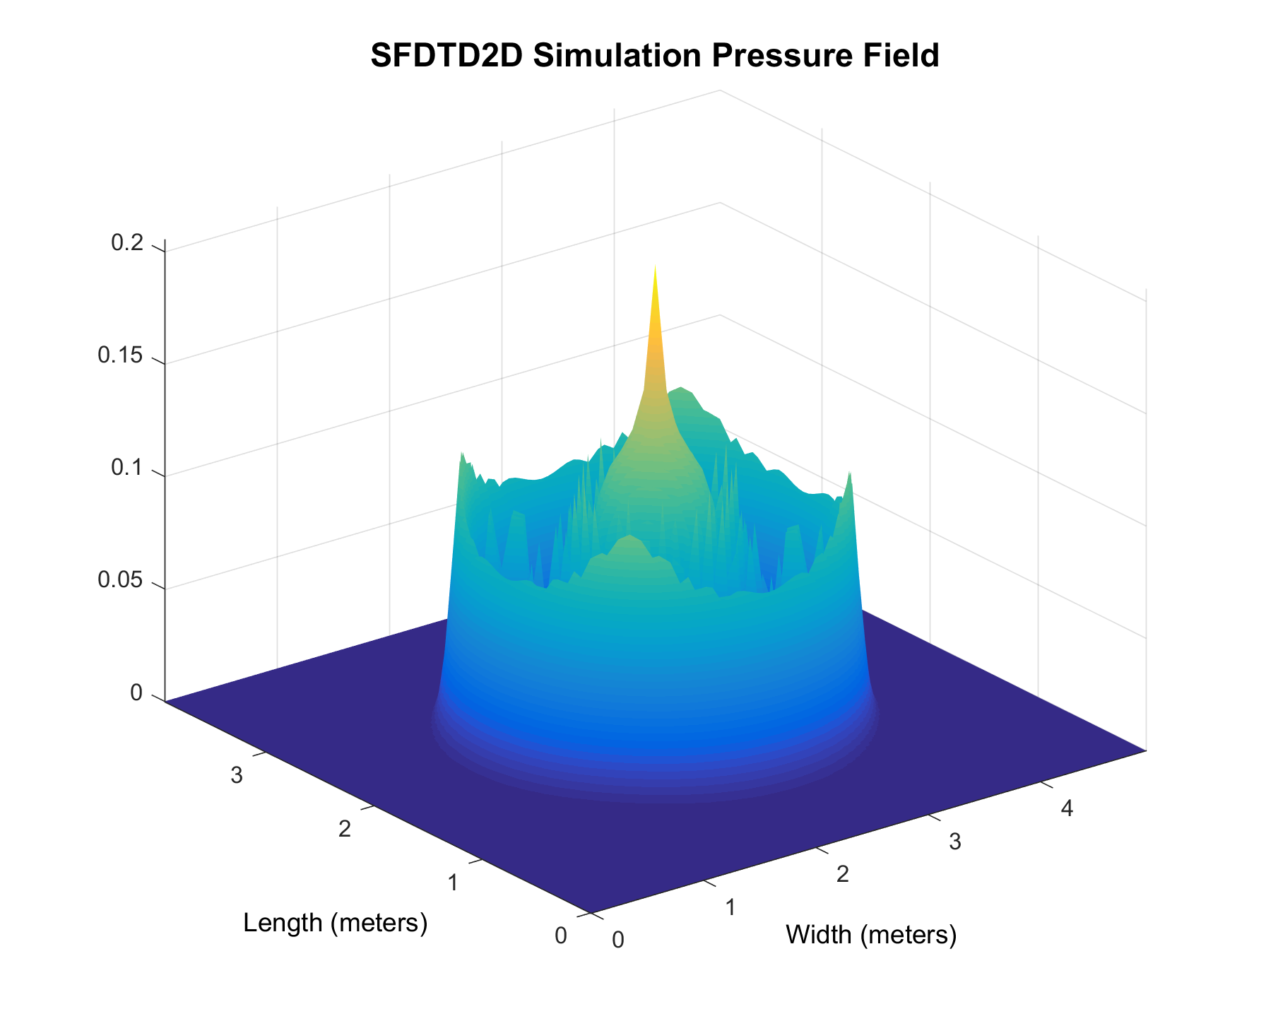
Finite Difference Methods
Sparse Finite Difference Time Domain

Slide 30
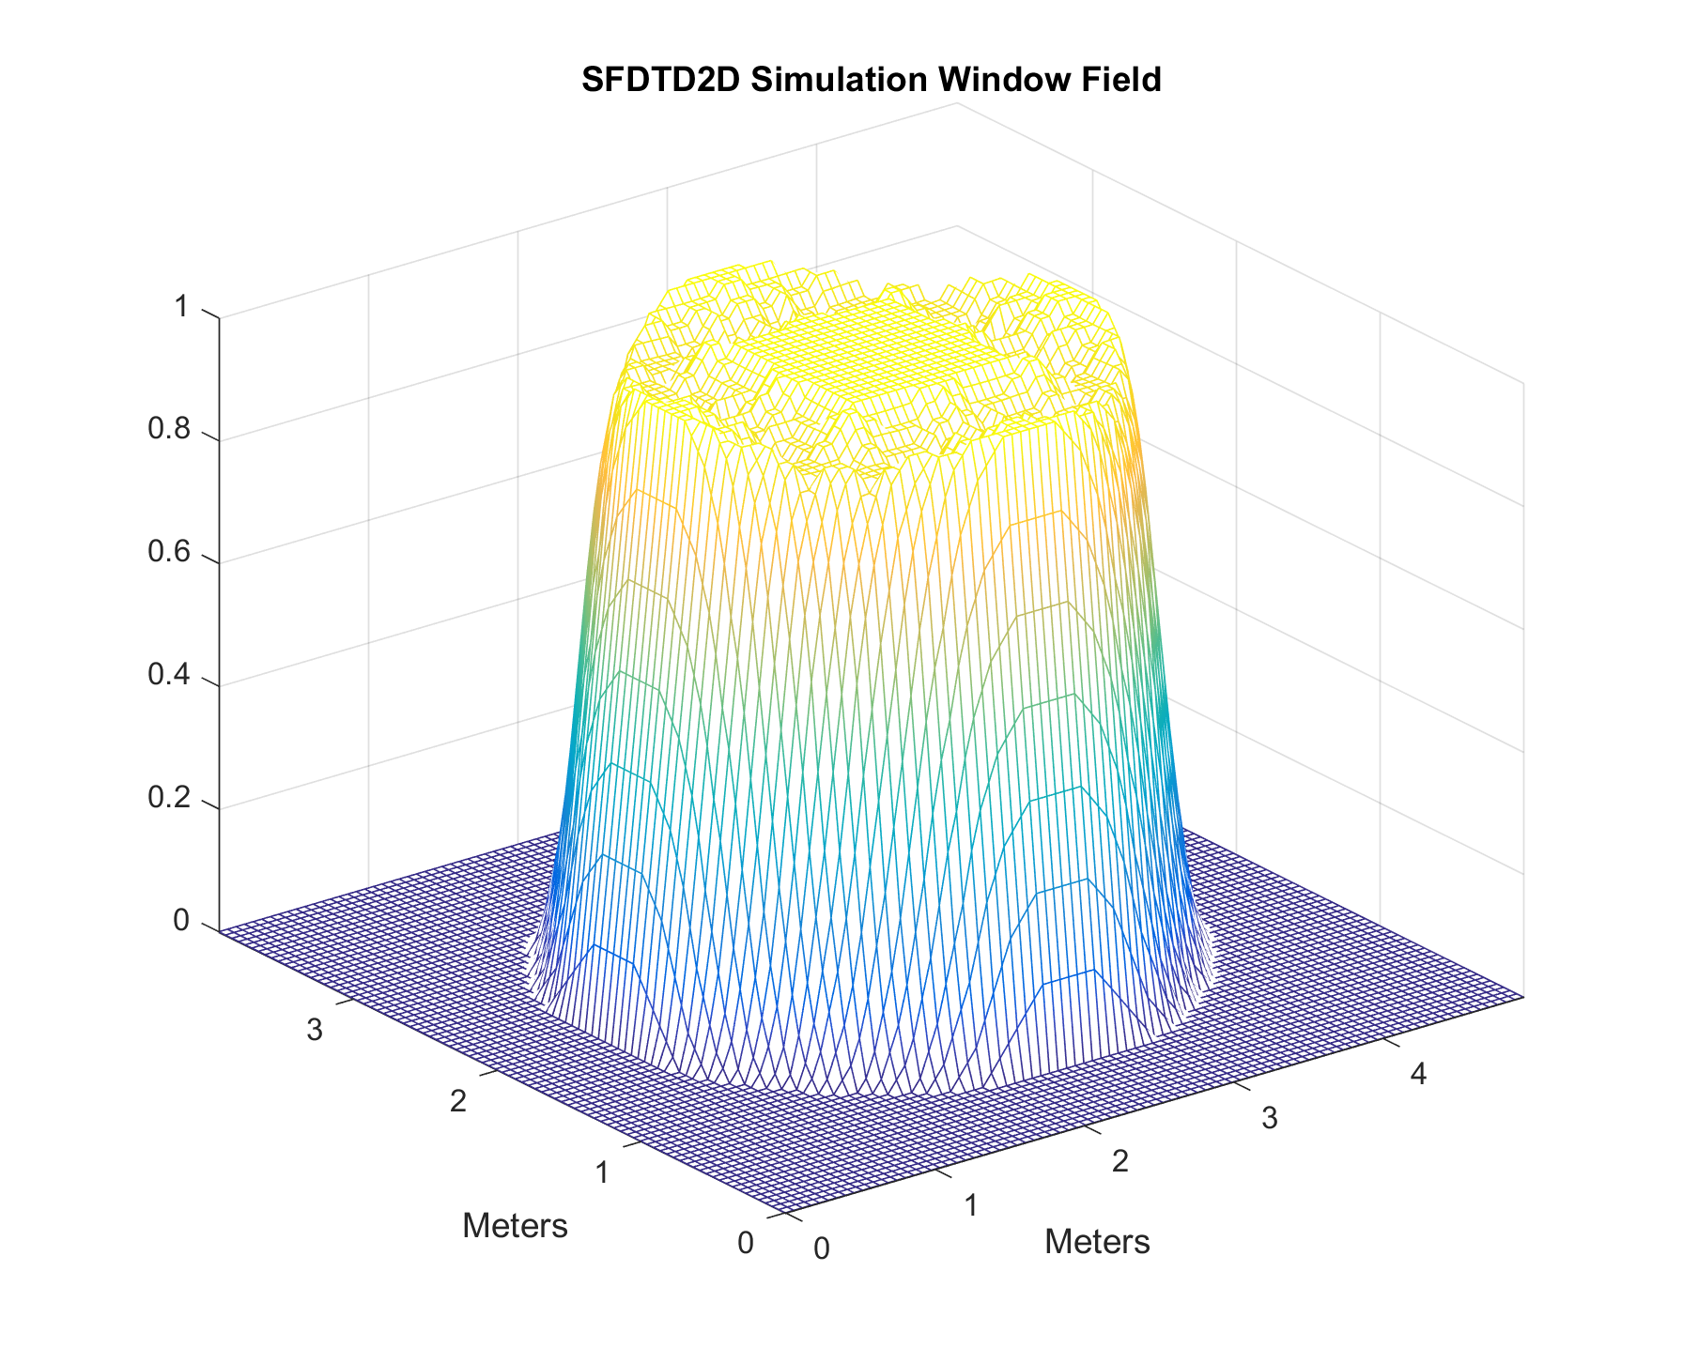
Finite Difference Methods
Sparse Finite Difference Time Domain

Slide 31
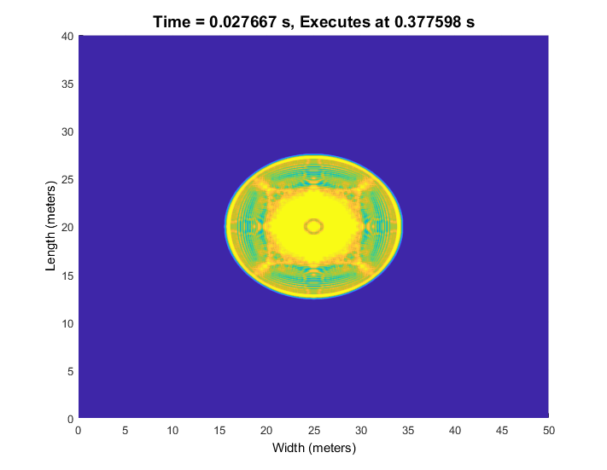
Finite Difference Methods
Sparse Finite Difference Time Domain 40dB Window Threshold

Slide 32
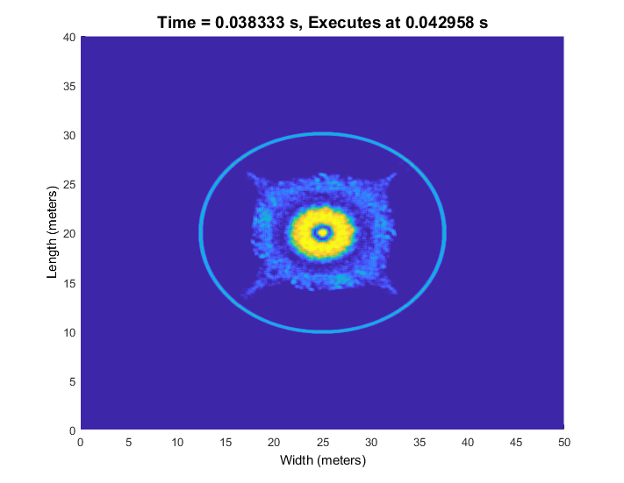
Finite Difference Methods
Sparse Finite Difference Time Domain 60dB Window Threshold

Slide 33
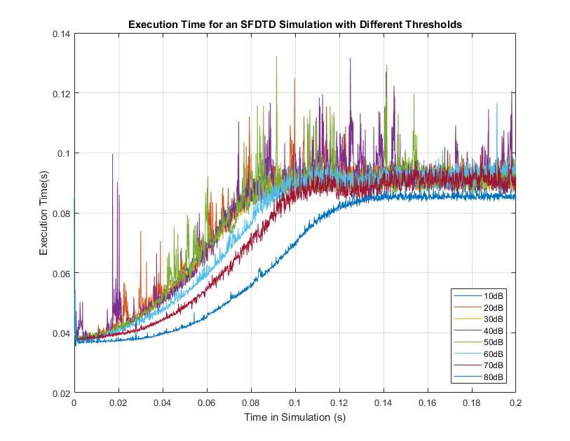
Finite Difference Methods
Sparse Finite Difference Time Domain Execution Speed For Different thresholds

Slide 34
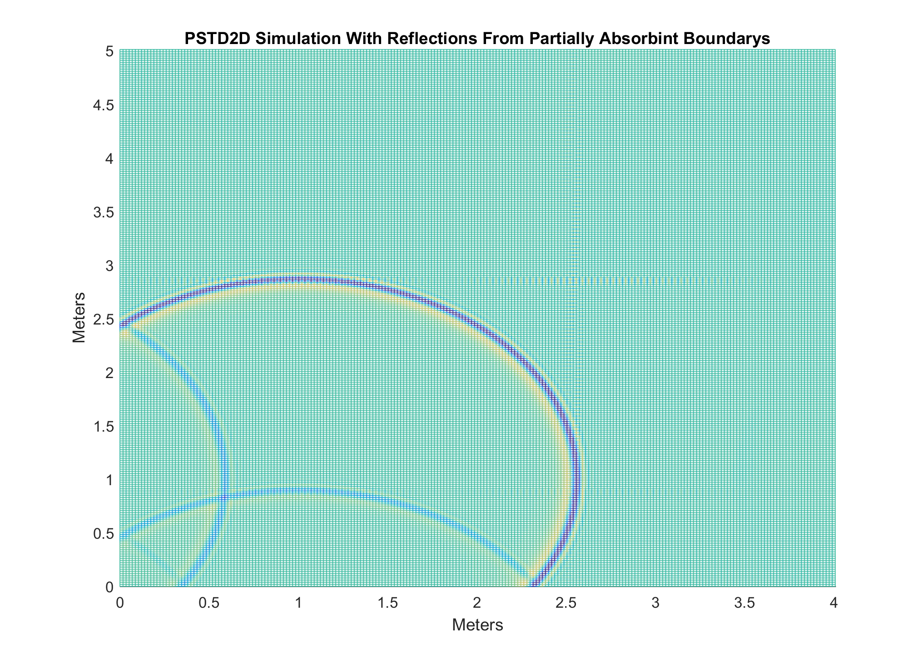
Finite Difference Methods
Pseudo-spectral Time Domain / Finite Difference Frequency Domain
http://www.salford.ac.uk/computing-science-engineering/cse-academics/jamie-angus

Slide 35
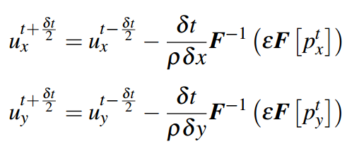
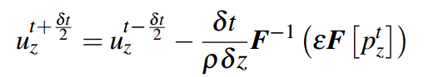
Finite Difference Methods
Pseudo-spectral Time Domain / Finite Difference Frequency Domain

Slide 36
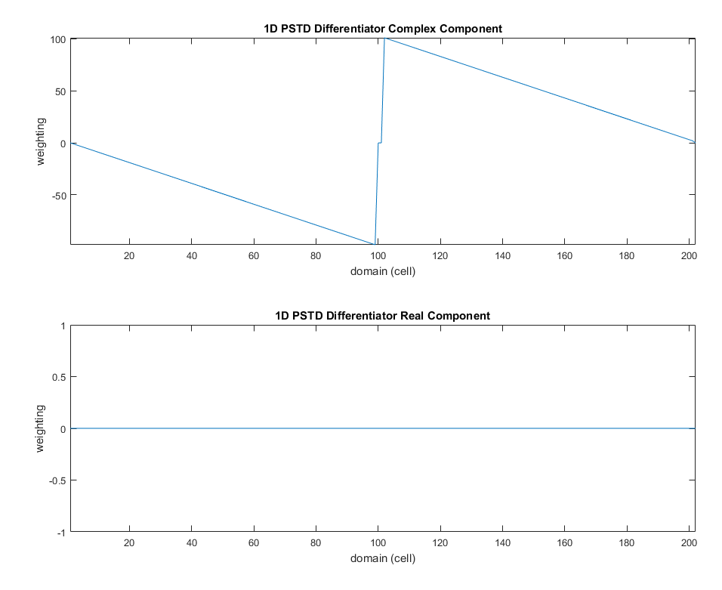
Finite Difference Methods
Pseudo-spectral Time Domain Differentiator

Slide 37
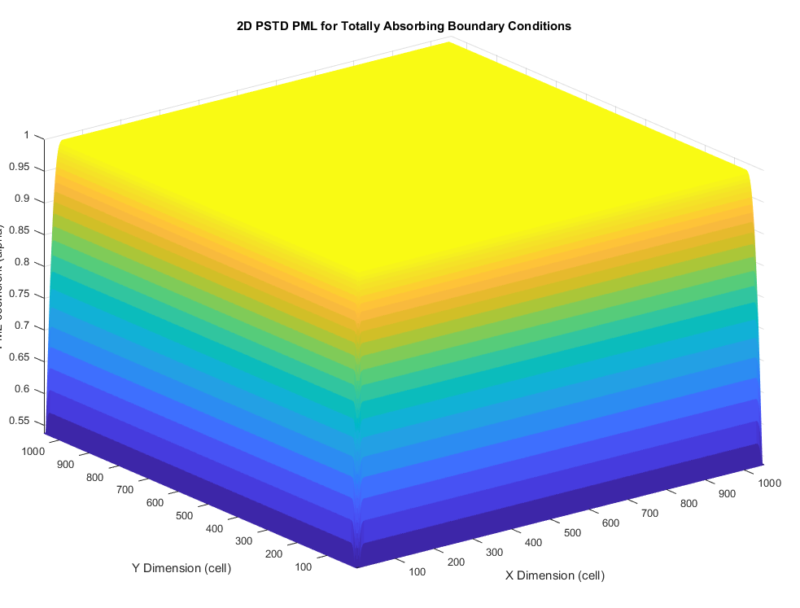
Finite Difference Methods
Pseudo-spectral Time Domain 2D Perfectly M

Slide 38
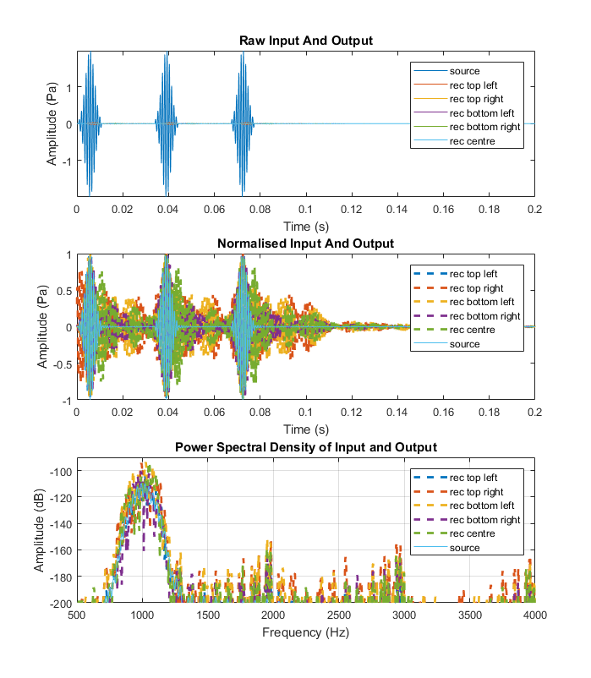
Validation – FDTD Tone Bursts

Slide 39

Validation – SFDTD Tone Bursts

Slide 40

Validation – PSTD Tone Bursts

Slide 41

Validation - Comparison

Slide 42

Experiment
Aim:
Test the execution speed of the time step for each method
Five domain sizes
${5m}^{3}$
${10m}^{3}$
${20m}^{3}$
${40m}^{3}$
${60m}^{3}$
500Hz Maximum Frequency

Slide 43

Experiment
Results Log Time Scale

Slide 44

Experiment
Results Linear Time Scale

Slide 45



Experiment
Finite Difference Method Execution Speeds

Slide 46

Experiment
Finite Difference Method Execution Speeds

Slide 47

Experiment
Finite Difference Method Execution Speeds

Slide 48

Experiment
Finite Difference Method Execution Speeds

Slide 49
Conclusion
PSTD was by far the fastest executing method, potentially due to the speed of execution of differentiation as an FFT, multiplication and IFFT
SFDTD shows some promise as a faster alternative to FDTD for very large domains (144703125+ cells), but much work has to be done to analyse and optimise this method
FDTD was the slowest method, but in this study gave better accuracy results than PSTD

Slide 50
Further Work
Experiment with PSTD method to improve results quality
Develop hybrid FDTD PSTD method for faster execution, but better discontinuity handling
Further explore SFDTD method windowing strategies through 3D filtering
Further explore potential differentiation methods for SFDTD to further improve execution speed
Develop obstacle implementation strategy for SFDTD
Implement SFDTD steps on GPU to improve execution speed
Explore a sparse matrix FDTD implementation by domain decomposition

Slide 51
Thank you for your time!
Any Questions?

Slide 52


Slide 53

References

Slide 54

References

Slide 55

References

